Slide 1
DecodeLabs Data Analytics Internship – Project 1

Slide 2
Data Cleaning & Preparation using Python (Pandas)
Tools Used:
Python
Pandas
Visual Studio Code
Excel

Slide 3
Project Objective
Goal: Clean a raw e-commerce dataset by identifying and correcting data quality issues.
Tasks Performed:
Identified missing values
Checked duplicate records
Corrected date formats
Standardized text values
Validated numeric fields
Created a cleaned dataset

Slide 4
Add Dataset Statistics
Total Records: 1200
Total Features: 14
Date Range: Jan 2023 – Jun 2025
Dataset Type: E-commerce Transactions

Slide 5
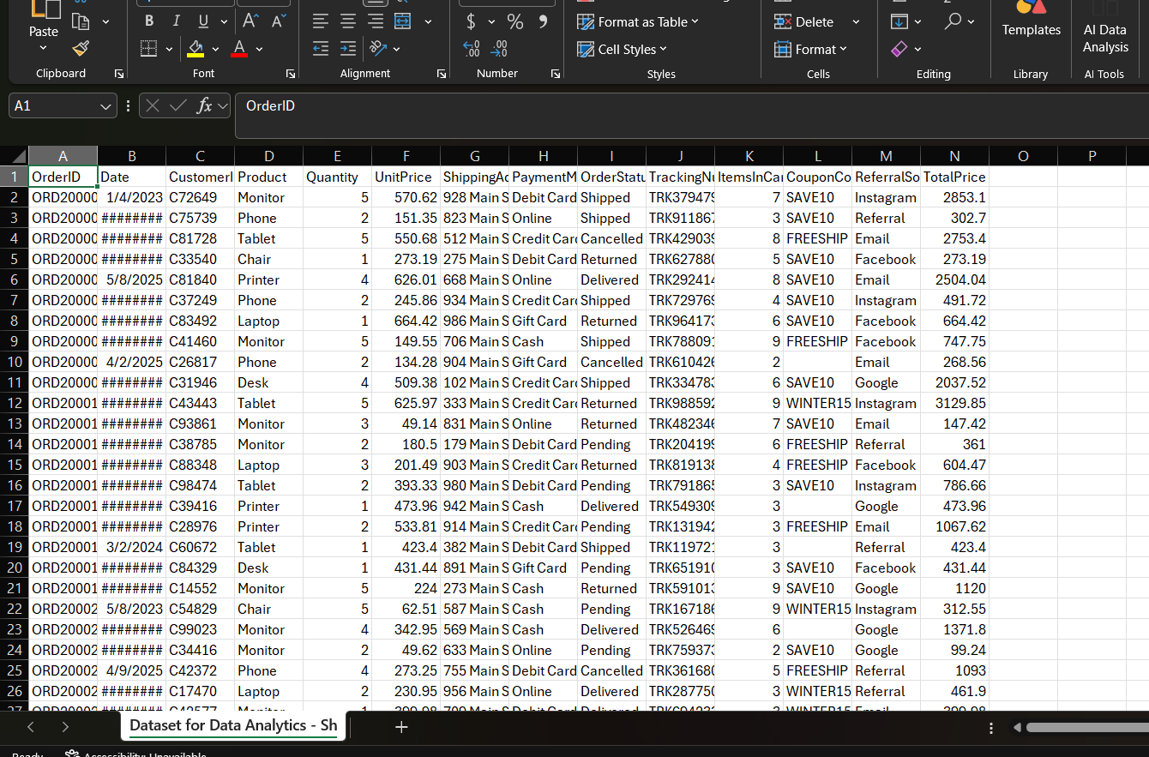
Dataset Overview

Slide 6
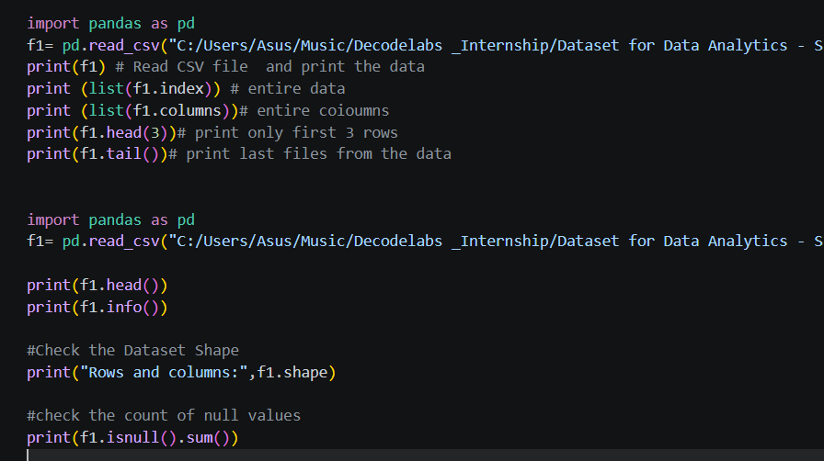

Slide 7

Data Cleaning Process

Slide 8
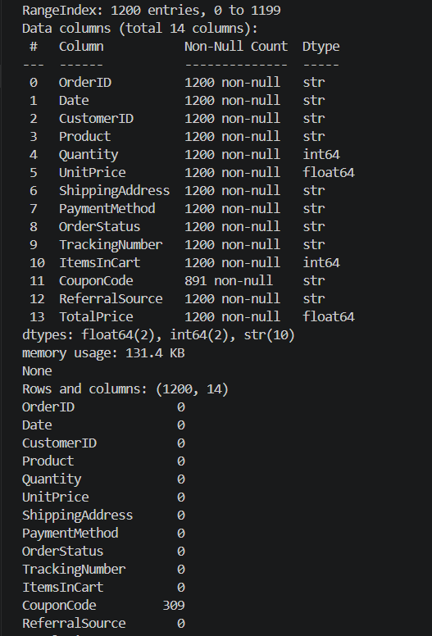
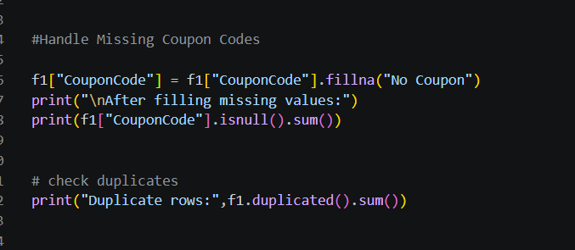
check duplicates

Slide 9
Date Conversion & Data Standardization

Slide 10
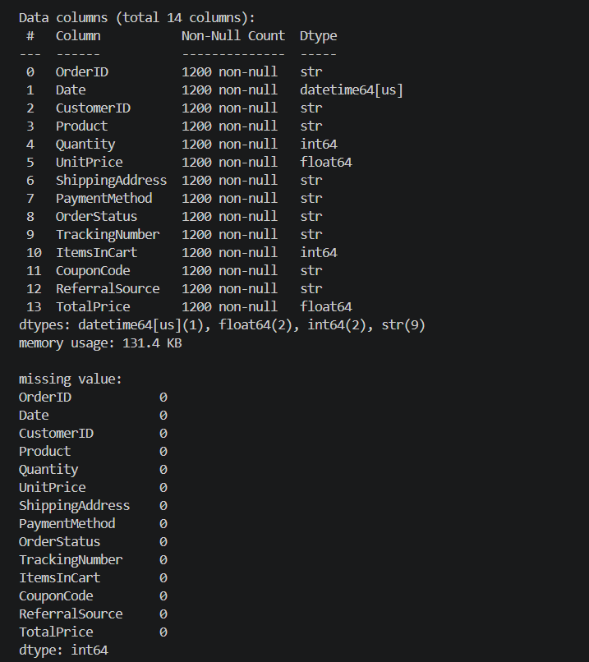
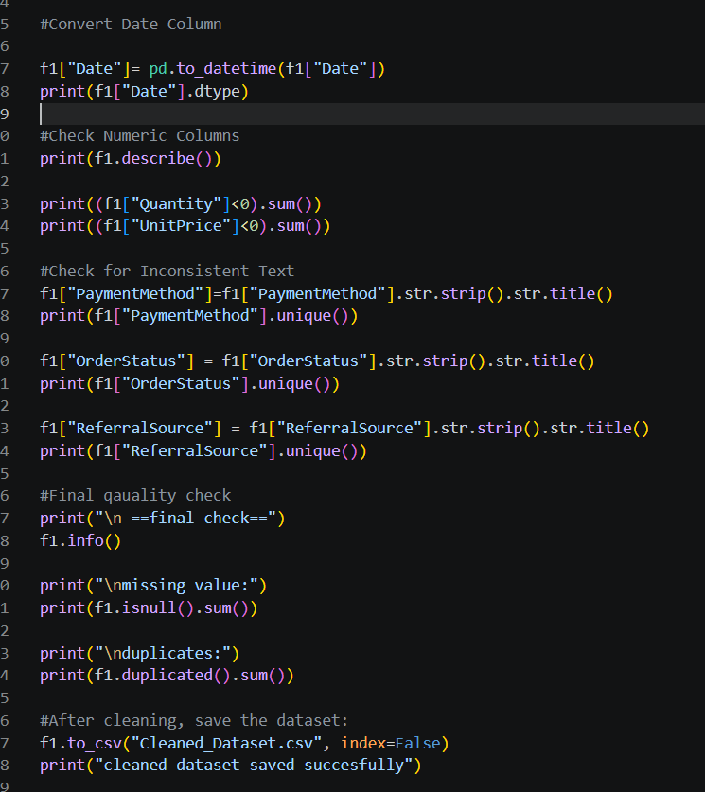

Slide 11
Final Dataset Quality Check
Results After Cleaning
Missing Values: 0
Duplicate Rows: 0
Date Format Standardized
Text Values Standardized
Clean Dataset Saved Successfully

Slide 12

Excel Implementation

Slide 13
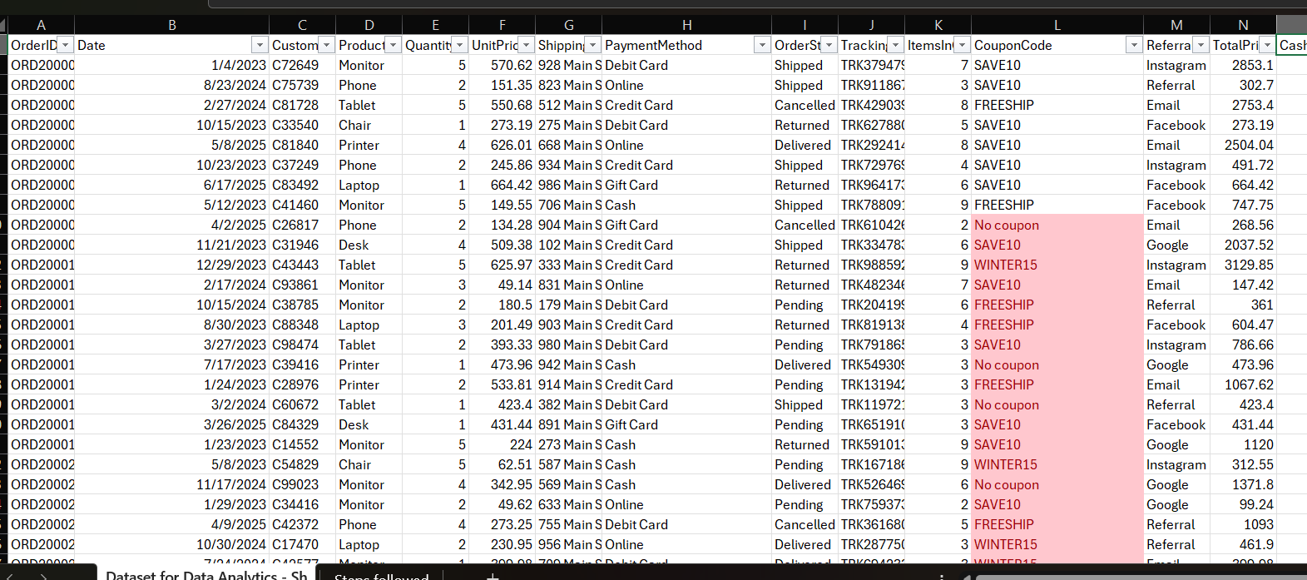

Slide 14
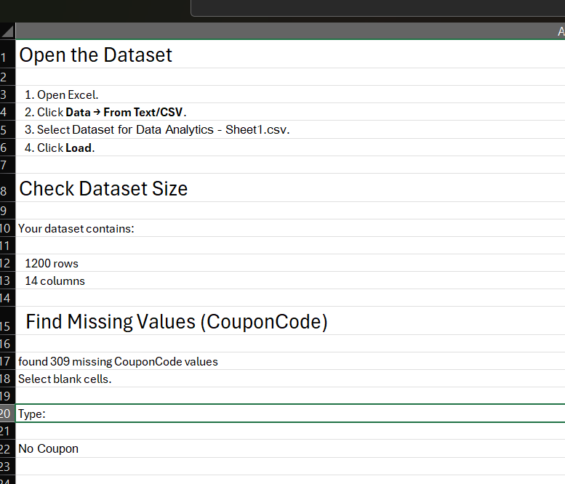

Slide 15
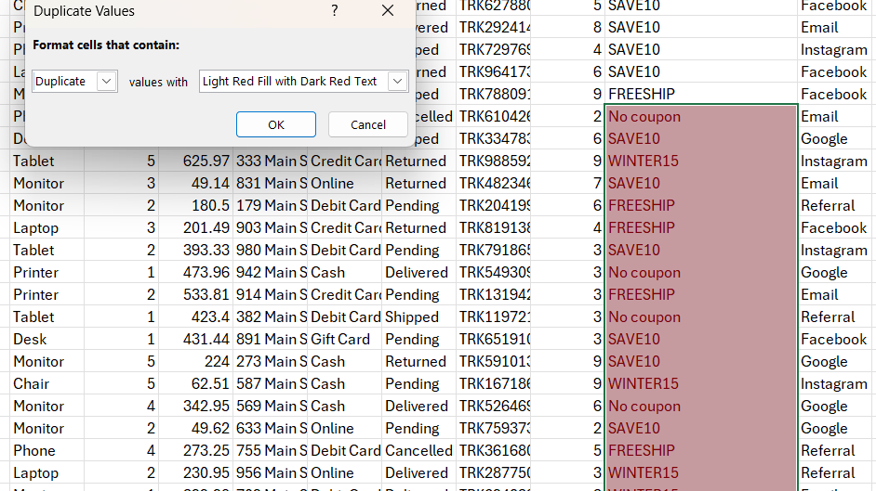
Check for Duplicate Order IDs

Slide 16
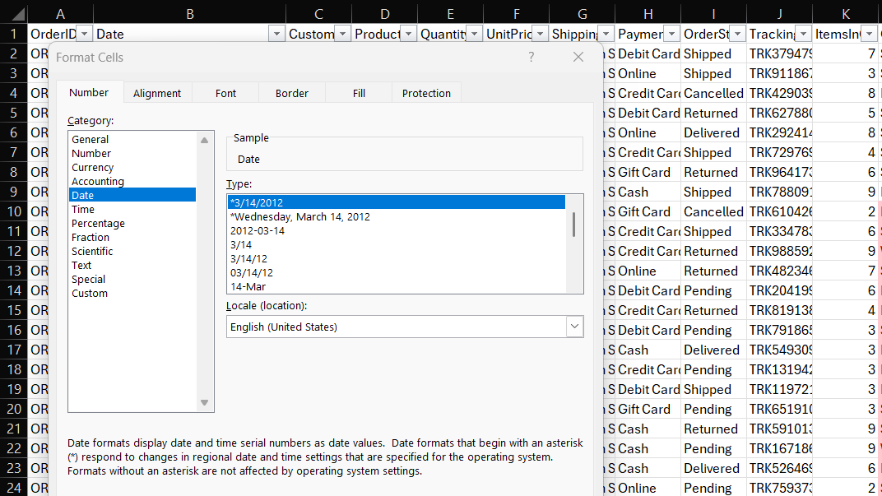
Convert Date Format

Slide 17
Data Cleaning Summary Sheet
Metric | Before Cleaning | After Cleaning
Missing Coupon Codes | 309 | 0
Duplicate Rows | 0 | 0
Invalid Dates | Checked | 0
Text Inconsistencies | Present | Standardized

Slide 18
Project Outcome
Successfully cleaned 1,200 transaction records
Resolved 309 missing CouponCode values
Standardized date and text formats
Verified zero duplicate records
Generated an analysis-ready dataset

Slide 19
Key Learnings
Learned practical data cleaning workflows
Gained hands-on experience with Pandas
Understood the importance of data quality
Practiced Excel and Python-based cleaning methods
Prepared datasets for future analytics and visualization

Slide 20
Thank you

